Slide 1
Development and Automated Testing of RESTful APIs Lesson 05
Prof. Andrea Arcuri
Kristiania University College, Oslo, Norway

Slide 2
Goals
See how test case generation can be modelled as an optimization problem, eg using Evolutionary Algorithms
Introduction to EvoMaster research tool, aimed at system testing of REST APIs
Disclaimer: this is based on my research work, and not something widespread in industry

Slide 3
Search-Based Software Testing

Slide 4
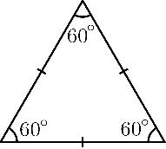

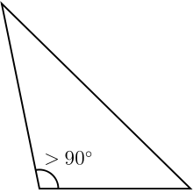
Example: Triangle Classification (TC)
Equilateral
Input
Output
A
Isosceles
SUT
B
Scalene
C
Not a triangle
3 integer numbers (A, B and C) as input representing the length of the edges
4 possible outcomes
Does the system under test (SUT) give the right answer?

Slide 5
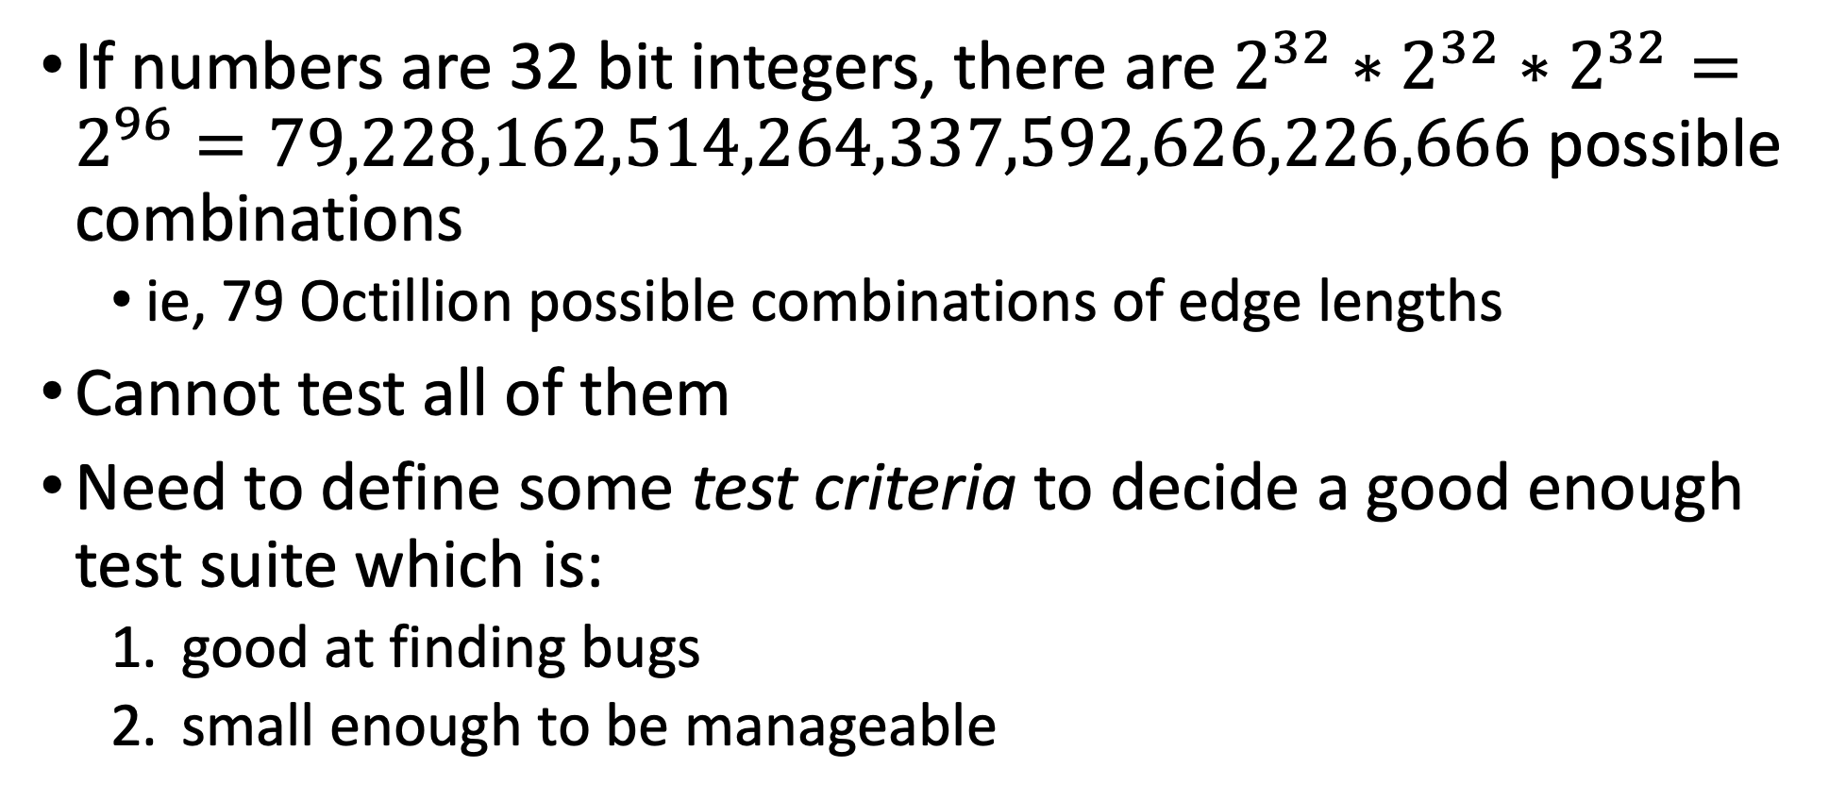
How to test TC?
If numbers are 32 bit integers, there are $2^{32}∗2^{32}∗2^{32}=2^{96}=79,228,162,514,264,337,592,626,226,666$ possible combinations
ie, 79 Octillion possible combinations of edge lengths
Cannot test all of them
Need to define some test criteria to decide a good enough test suite which is:
good at finding bugs
small enough to be manageable

Slide 6
1 Test per Output
t0:(A=42, B=42, C=42) => EQUILATERAL
t1:(A=42, B=42, C=5) => ISOSCELES
t2:(A=42, B=43, C=44) => SCALENE
t3:(A=42, B=42, C=12345) = NOT A TRIANGLE
Would such 4 test cases be enough?
What if the EQUILATERAL case is implemented with just something as naïve as “if A==B and B==C then EQUILATERAL”?
(A=-3, B=-3, C=-3) would wrongly return EQUILATERAL instead of NOT A TRIANGLE
Just checking basic scenarios is not enough

Slide 7
White-Box Testing
public Classification classify(
int a, int b, int c){ if(a <=0 || b<= 0 || c<= 0){ return Classification.NOT_A_TRIANGLE; } if(a==b && b==c){ return Classification.EQUILATERAL; } int max = Math.max(a, Math.max(b,c)); if( (max == a && max -b -c >= 0 ) || (max == b && max -a -c >= 0 ) || (max == c && max -a -b >= 0 ) ){ return Classification.NOT_A_TRIANGLE; } if(a==b || b==c || a==c){ return Classification.ISOSCELES; } else { return Classification.SCALENE; } }
Code can have bugs
To trigger a bug, the code must be executed
But code can have very complex control flow
Some rare “paths” in the code might be executed only in very complex scenarios
Goal: in a test suite, have each single line and branch be executed at least once

Slide 8
Example
if( (max == a && max -b -c >= 0 ) || (max == b && max -a -c >= 0 ) || (max == c && max -a -b >= 0 ) )
In this disjunction of 3 different clauses, if in your test suite the first clause is always true, the other 2 would never be executed
so if wrong, you would not know
This is a TRIVIAL example… real industrial software can be way more complex…
Writing tests for each path is not only tedious, but can be quite hard as well

Slide 9
Automated Test Case Generation
Automatically generate test cases
Model software testing as an optimization problem
Maximize code coverage
Find bugs
Etc.
Use optimization algorithms
Benefits: cheaper and more effective than manual testing
Hard problem to automate
given a non-linear constraint, there is no guaranteed algorithm that can solve it in polynomial time

Slide 10
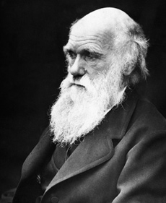
Search-Based Software Testing (SBST)
Biology meets Software Engineering (SE)
Casting SE problems into Optimization Problems
Genetic Algorithms: one of most famous optimization algorithm, based on theory of evolution
Evolve test cases

Slide 11
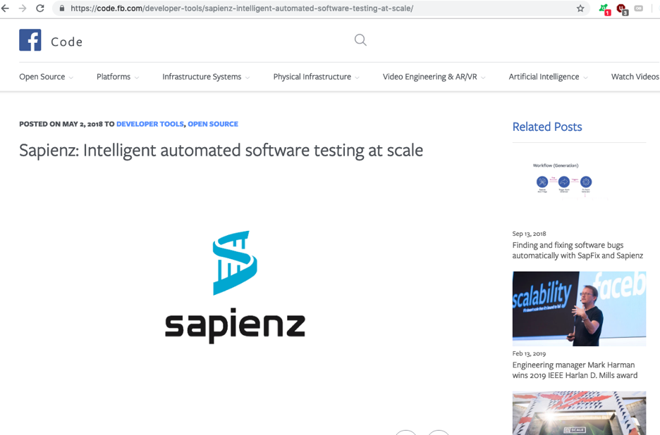
Success Stories: Facebook
Facebook uses SBST for automatically testing their software, especially their mobile apps
eg, tools like Sapienz and SapFix

Slide 12
Search Space
Depends on testing problem
Unit testing of TC? space of all possible combination of 3 integer inputs
OO software? sequence of function calls, with their heterogenous inputs
REST APIs? sequence of HTTP calls, setting strings like query parameters, and JSON/XML body payloads, etc.

Slide 13
Search Operators
Depend on the representation of the genes
Usually, small changes on the genes
Integer inputs? add +-1 on them
Strings? add/remove/change single chars in them
Object? modify 1 of their fields
etc.

Slide 14
Fitness Guidance
Just using code coverage as fitness function is not enough
binary: either we cover or we do not cover a target
Need guidance to be able to solve constraints in code predicates
“if(x == 123456 && complexPredicate(y) )”
Would be extremely difficult to get the right x and y to solve that predicate at random

Slide 15
SBST Heuristics: Branch Distance
Standard technique in the SBST literature to solve constraints
Example: if(x==100)
both 5 and 90 do not solve the constraint, but 90 is heuristically closer
Distance to minimize: if 0, then predicate is solved
Not just for integers, but also all other types, eg strings
Need to instrument the code to calculate those branch distances
Bytecode manipulation: need it fully automatically, eg with class loaders and Java Agents
Lot of technical details on how to achieve it efficiently

Slide 16
Branch Distance Examples
d(x == y) = |x-y|
d(x >= 0) = 0 if x>=0, -x otherwise
d(A && B) = d(A) + d(B)
d(A || B) = min(d(A), d(B))
etc.

Slide 17
EvoMaster

Slide 18
What about Automated Test Generation for RESTful APIs?
Would be very useful for enterprises
No tool available (AFAIK)
In the past, quite a lot of work on SOAP web services
(which are not so common any more)
Very few papers on testing REST
Most techniques are black box

Slide 19
EvoMaster: Evolutionary Multi-Context Automated System Testing
Tool to automatically generate tests for REST APIs
White box
can exploit structural and runtime information of the SUT
Search-based testing technique (SBST)
Fully automated
Open-source prototype: www.evomaster.org
Currently targeting JVM languages (eg Java and Kotlin)

Slide 21
OpenAPI/Swagger
REST is not a protocol
Need to know what endpoints are available, and their parameters
Schema defining the APIs
Swagger is the most popular one
Defined as JSON file, or YAML
Many REST frameworks can automatically generate Swagger schemas from code

Slide 22
EvoMaster Core
From Swagger schema, defines set of endpoints that can be called
Test case structure:
setup initializing data in DB with SQL INSERTs
sequence of HTTP calls toward such endpoints
HTTP call has many components:
Verb (GET, POST, DELETE, etc.)
Headers
Query parameters
Body payload (JSON, XML, etc.)
Evolutionary algorithm to evolve such sequences and their inputs
Output: self-contained JUnit tests

Slide 23
Fitness Function
Needed to drive the evolution
Reward code coverage and fault detection
HTTP return statuses as automated oracles:
Eg 2xx if OK, 4xx are user errors, but 5xx are server errors (often due to bugs)

Slide 24
EM Driver: SBST Heuristics as a Service
Core and Driver are running on different processes
Code coverage and branch distances sent over the net, in JSON format
Cannot send all data: too inefficient if per test execution
different techniques to determine only what is necessary
EM Driver is itself a RESTful API
Why? Because so we can use Driver for other languages (eg C# and JS) without the need to touch EM Core

Slide 26
Many Independent Objective (MIO) Algorithm

Slide 27
Search Algorithms for System Testing
There are many search algorithms
Genetic Algorithms, Simulated Annealing, Ant Colony, etc.
No Free Lunch Theorem
on all possible problems, all algorithms have same average performance, ie, there is no best algorithm
Customized algorithms that exploit domain knowledge will give better results

Slide 28
Properties of System Testing (eg for Web Services)
To increase coverage, you can add new tests to existing test suite
Testing objectives can be sought independently
Minimizing the number of tests is still important, but secondary
System tests are expensive to run (eg compared to unit tests)
Less number of fitness evaluations: put more emphasis on exploitation vs exploration of the search landscape
Many, many test objectives (e.g., lines and branches)
Even in the tens/hundreds of thousands…
Some test objectives could be infeasible
Any resource spent in covering them is wasted

Slide 29
Many Independent Objective (MIO) Algorithm
Multi/Many Objective Optimization (MOO)
Evolve populations of test cases
Final output: a test suite
At a high level, it can be considered like a multi-population (1+1)EA

Slide 30
Issues With Existing MOO Algorithms
Eg, SPEA-2 and NSGA-2
Usually handle just a small number of objectives, eg 3-5
might not scale to hundreds/thousands of objectives
Difficult to choose a population size when large and variable number of objectives

Slide 31
Dynamic Number of Populations
One population of tests for each testing target (eg, line or branch)
Each population has up to N tests
Initially 0 populations
Every time a target is reached but not covered, we create a population for it
Eg, a code block inside an if statement with complex predicate
Why? Before running, do not know how many targets there are.

Slide 32
MIO Main Loop
Each iteration, sample a test
Sample either at random, or from one population for non-covered targets, based on probability P
If from population, apply M mutations
Might copy to all existing populations in archive
override fun search(): Solution<T> {
time.startSearch()
while(time.shouldContinueSearch()){ val randomP = apc.getProbRandomSampling() if(archive.isEmpty() || randomness.nextBoolean(randomP)) { val ind = sampler.sample() ff.calculateCoverage(ind)?.run { archive.addIfNeeded(this) } continue } val ei = archive.sampleIndividual() val nMutations = apc.getNumberOfMutations() getMutatator().mutateAndSave(nMutations, ei, archive) } return archive.extractSolution() }

Slide 33
Mutation Operator
Standard, like in any evolutionary algorithm
Small modifications
+- delta on numbers
change some characters in strings
etc.

Slide 34
Simple Example
public boolean equalAndPositive(int x, int y)
{ if(x <= 0) return false; //T1 //T2 if(x==y){ //T3 //infeasible if(y <= 0) return false; //T4 //T5 return true; } //T6 return false; }
Let’s consider just branch coverage
3 branches -> 6 targets
T1 to T6
One branch is infeasible
Note: just an example… not really an efficient function…

Slide 35
1st Step
public boolean equalAndPositive(int x, int y)
{ if(x <= 0) return false; //T1 //T2 if(x==y){ //T3 //infeasible if(y <= 0) return false; //T4 //T5 return true; } //T6 return false; }
Assume sampling <-5,-2>
first step will be at random
Would be created 2 populations, as we only see 2 targets
Test case copied in both populations
Target T1 is covered
T1 | -5, -2
T2 | -5, -2

Slide 36
Population Choice
After few iterations, might have many populations
In main loop, sample 1 test from 1 population
Population is chosen at random among targets not fully covered yet
Ie, concentrate search on targets that still need to be covered

Slide 37
2nd Step
public boolean equalAndPositive(int x, int y)
{ if(x <= 0) return false; //T1 //T2 if(x==y){ //T3 //infeasible if(y <= 0) return false; //T4 //T5 return true; } //T6 return false; }
Sample new individual with probability P, or copy&mutate existing <-5,-2> with probability 1-P
Assume sampling <-3,7>
Still only 2 populations
T1 ignored, as already covered
T1 | -5, -2
T2 | -5, -2 | -3, 7

Slide 38
3rd Step
public boolean equalAndPositive(int x, int y)
{ if(x <= 0) return false; //T1 //T2 if(x==y){ //T3 //infeasible if(y <= 0) return false; //T4 //T5 return true; } //T6 return false; }
Assume sampling <1,7>
2 new populations, as now T3 and T6 are reached
All covered but T3
T1 | -5, -2
T2 | -5, -2 | -3, 7 | 1, 7
T3 | 1, 7
T6 | 1, 7

Slide 39
Population Management
A single population hold up to N tests (eg 10)
Tests in a population X have fitness values based only on target X.
When adding new test and size become > N, delete worst test
When sampling from population, done at random
If target gets covered, population shrinks to 1, keeping best test
T1 | -5, -2
T2 | -5, -2 | -3, 7 | 1, 7
T3 | 1, 7
T6 | 1, 7
T1 | -5, -2
T2 | 1, 7
T3 | 1, 7
T6 | 1, 7

Slide 40
4th Step
Could sample at random with P
Could copy&mutate from existing population with 1-P
As all covered but T3, can only use T3 for sampling
Assume mutating <1,7> with a x+2, giving <3,7>
Added only to population for T3, as others are covered
T1 | -5, -2
T2 | 1, 7
T3 | 1, 7
T6 | 1, 7
T1 | -5, -2
T2 | 1, 7
T3 | 1, 7 | 3, 7
T6 | 1, 7

Slide 41
5th Step
Assume adding <7,7>, which would cover T3 and T5
T3 will then be shrunk to single individual
T1 | -5, -2
T2 | 1, 7
T3 | 1, 7 | 3, 7
T6 | 1, 7
T1 | -5, -2
T2 | 1, 7
T3 | 1, 7 | 3, 7 | 7, 7
T6 | 1, 7
T4 | 7, 7
T5 | 7, 7

Slide 42
Population Size Limit
Assume limit N=5
When population too large, need to shrink, based on fitness
Eg, a new <6,7> would replace the very bad <42,1000>
T3 | 1, 7 | 3, 7 | 42, 1000 | 4, 1 | 5, 2
T3 | 1, 7 | 3, 7 | 6, 7 | 4, 1 | 5, 2

Slide 43
Feedback-directed Sampling
If target is infeasible, waste of time sampling from its population
But not possible to determine if target is infeasible
Solution:
Add counter to each population, initialized to 0
Each time sampling from population, increase counter by 1
New better test added to population? Reset counter to 0
When choosing population to sample, instead of random, choose lowest counter
Effects: concentrate search on targets for which we get fitness improvements
After a while, never sample again from populations for infeasible targets

Slide 44
Exploration vs Exploitation
Beginning of search, want to explore large parts of search landscape
Later in the search, concentrate to improve current best tests
Not much left time to try new different tests
This is controlled by 2 main parameters: sampling P, population size N
Parameter Control: during search, decrease P and N
Similar to Simulated Annealing
When N shrink, remove worst test
Example:
0% search budget: P=1 -> practically random testing
25% search budget: P=0.5, N=10 -> population based search, with still some random sampling
50% search budget: P=0, N=1 -> no random sampling, concentrate on single individual per target

Slide 45
Final Test Suite
T4 is infeasible… never be covered, but could have gradient to get <1,1>
Test suite based only on covered targets, with no duplicates
this means <1,1> will not be part of final test suites
there are duplicates for <1,7> and <7,7>
Final suite contains 3 tests: <-5,-2> <1,7> <7,7>
T1 | -5, -2
T2 | 1, 7
T3 | 7, 7
T6 | 1, 7
T4 | 1, 1
T5 | 7, 7

Slide 46
Further Optimizations
Even if a test cover a target X, might not be the best
There could be “shorter” test cases
Other test cases could cover X plus other targets as well
If those tests are generated, those would replace the one stored in the population for X

Slide 47
Handling Databases

Slide 48
Database Interactions
Given a DB like Postgres, using SQL to query and modify the DB
The execution flow of the SUT can depend on the results of the SQL queries
eg, IF statements executing different code blocks if a SQL query returned no data
Branch Distance heuristics does no give any help here
To improve coverage, we need to analyze the interactions of the SUT with the DB

Slide 49
Example: SpringBoot + Hibernate for HTTP REST
@RestController
@RequestMapping ( path = "/api/foo" )
public class FooRest {
@Autowired private FooRepository repo ;
@RequestMapping ( method = RequestMethod.POST )
public void post( ) {
FooEntityentity = new FooEntity( ) ;
entity.setX ( 42 ) ;
entity.setY ( 77 ) ;
repo.save(entity) ;
}
@RequestMapping( path = " / { x } / { y } " ,
method = RequestMethod.GET,
produces = MediaType.APPLICATION_JSON_VALUE )
public ResponseEntityget (
@PathVariable ("x") int x,
@PathVariable ("y") int y) {
List<FooEntity> list = repo.findByXIsAndYIs( x , y ) ;
i f ( list.isEmpty( ) )
return ResponseEntity.status(400).build( ) ;
e l s e
return ResponseEntity.status(200).build( ) ;
}
}
public interface FooRepository extends CrudRepository<FooEntity, Long> {
List<FooEntity> findByXIsAndYIs( Integer x, Integer y) ;
}
Need to be run in a servlet container like Tomcat
2 HTTP endpoints
POST /api/foo
create new row in database with a predefined x and y columns
GET /api/foo/{x}/{y}
check if there exists any row in database with given x and y passed in the URL

Slide 50
No Gradient
repo.findByXIsAndYIs(x,y) will execute a SQL query on DB
No gradient here to help finding x and y for which list.isEmpty() returns false
Content of list depends on the state of DB
List<FooEntity> list = repo.findByXIsAndYIs( x , y ) ;
i f ( list.isEmpty( ) )
return ResponseEntity.status(400).b u i l d ( ) ;
e l s e
return ResponseEntity.status(200).b u i l d ( ) ;

Slide 51
public interface FooRepository extends
CrudRepository<FooEntity, Long> {
List<FooEntity> findByXIsAndYIs(Integer x, Integer y) ;
}
SUT code might have no direct SQL code
Eg, in this example, Spring generates SQL at runtime based on name of function in a CrudRepository interface
SELECT foo0_.id, foo0_.x , foo0_.y FROM foo_entity foo0_ WHERE foo0_.x=? and foo0_.y=?
Between the interface method call and the actual SQL command on DB, there can be tens of function calls
eg, see stack trace on the left

Slide 52
SQL Handling: First Steps
Need to intercept ALL SQL commands made by the SUT, regardless of which tool or framework is used to build the application
In Java, this is easy: start the SUT with a JDBC wrapper like P6Spy
Heuristic: try to reward inputs for which SQL queries return at least some data, ie not empty

Slide 53
WHERE Clause
Whether a SQL SELECT returns any data depends on whether its WHERE clause (if any) does evaluate to true
SELECT foo0_.id, foo0_.x , foo0_.y FROM foo_entity foo0_ WHERE foo0_.x=? and foo0_.y=?
Compute distance similar to branch distance, to minimize
need to handle special SQL boolean operators such as LIKE, SIMILAR TO and IN

Slide 54
Example
Each time a SQL is executed, we need to read state of the database
only the involved tables
For each row, compute distance, and return minimum
d()=2 in this case
Eg, x=10, y=20
d(foo.x,foo.y)= |foo.x-10|+|foo.y-20|
This also helps rewarding other actions writing data into DB with values close to x=10 and y=20
GET /api/foo/10/20
Table Foo
ID | X | Y
0 | 0 | 0
1 | 10 | 18
2 | 5 | 20
d()
30
2
5

Slide 55
Integration in the Search
Our main objectives are to maximize coverage and fault finding
Rewarding non-empty SQL SELECTs is just a secondary objective which hopefully would help with the main objectives
When two individuals A and B have the same fitness value, we look at the secondary objectives to decide which one is better for selection

Slide 56
SQL Data Generation
At times, SQL SELECTs are not parametric (ie constant)
eg, “WHERE x=?” vs “WHERE x=42”
Instead of finding the right input to SUT, we need first to call previous actions that create the right data in the DB
Finding such sequence of actions could be very complex
and make tests harder to read/understand for developers if sequence is long
Might even be impossible if DB is read-only
eg, SUT cannot write on it, where other programs do it
We need to able to generate SQL data directly into the DB as part of the search

Slide 57
Example: only GET
@RestController
@RequestMapping ( path = "/api/foo" )
public class FooRest {
@Autowired private FooRepository repo ;
@RequestMapping( path = " / { x } / { y } " ,
method = RequestMethod.GET,
produces = MediaType.APPLICATION_JSON_VALUE )
public ResponseEntityget (
@PathVariable ("x") int x,
@PathVariable ("y") int y) {
List<FooEntity> list = repo.findByXIsAndYIs( x , y ) ;
i f ( list.isEmpty( ) )
return ResponseEntity.status(400).build( ) ;
e l s e
return ResponseEntity.status(200).build( ) ;
}
}
public interface FooRepository extends CrudRepository<FooEntity, Long> {
List<FooEntity> findByXIsAndYIs( Integer x, Integer y) ;
}
Only: GET /api/foo/{x}/{y}
No way to generate data in DB by calling the SUT
If a test case is only a sequence of HTTP calls on the REST web service, would be impossible to achieve full code coverage

Slide 58
Solution: SQL Generation in the Tests
Test case not only sequence of HTTP calls (or GUI actions), but also SQL commands
Issue: no point in adding SQL INSERT in a test for a table Foo if such test never does a SELECT on such table
Optimization: once a test case is executed, and we know all of its SELECTs, then enable SQL commands only for the involved tables (if any)
Mutation operation: change content of columns, but not tables or number of SQL commands (eg insert or delete)

Slide 59
Example
JUnit test, covering that branch
2 actions:
SQL INSERT of x=1177 and y=536
HTTP GET for x=1177 and y=536
Here, mutation operation would work on 4 variables
Mutation operator can create new HTTP calls or delete existing ones, but not SQL
those will be automatically added or removed based on what SELECT commands the SUT will execute during the HTTP calls
@Test
public void test1( ) throws Exception {
List<InsertionDto> insertions = sql( )
.insertInto("FOO_ENTITY", 8L)
.d("X" , "1177")
.d("Y" , "536")
.dtos( ) ;
controller.insertIntoDatabase(insertions) ;
given( ).accept("∗ / ∗")
.get(baseUrlOfSut + "/api/foo/1177/536")
.then()
.statusCode(200);
}

Slide 60
SQL Insertion Challenges
Handling of Primary and Foreign Keys
Handling of constraints in the database tables
eg, unique columns
Handling of auto-increment columns
eg, might need to insert data for 2 tables A and B, where A has a FK to B, but the PK of B is auto-increment and so unknown before the test is executed

Slide 61
Conclusion
Search-based Software Testing is an active and promising research field
Aim: generate test cases automatically
EvoMaster: research tool aimed at REST APIs
Promising results, but still many challenges need to be addressed
eg, microservices

Slide 62
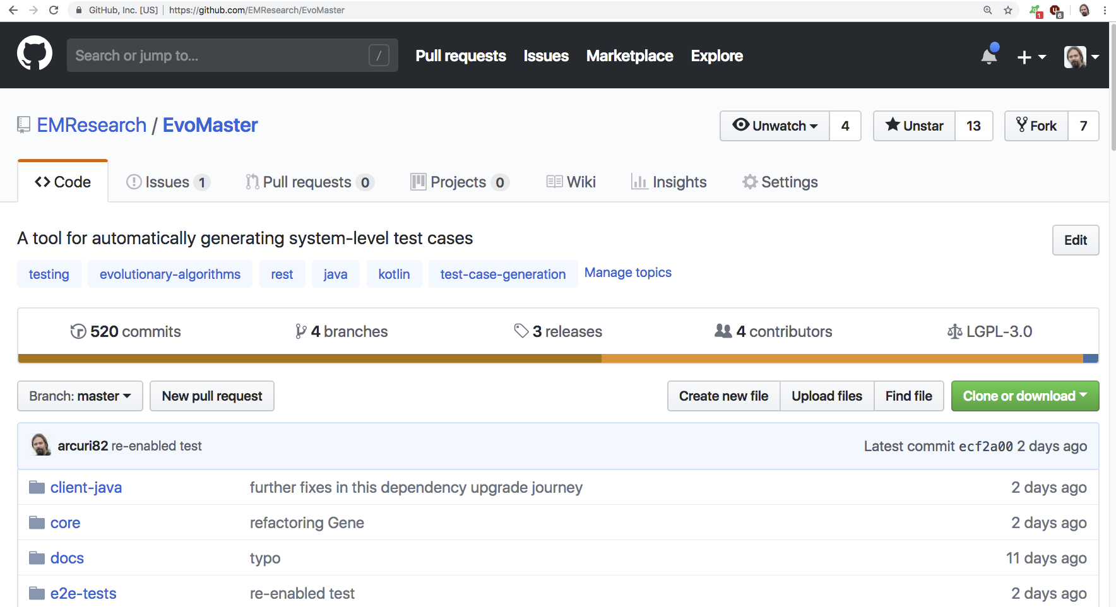
www.evomaster.org

Slide 63
Demo

